Slide 1


JULLUNDRA ENGG. WORKS
A Preview

Slide 2
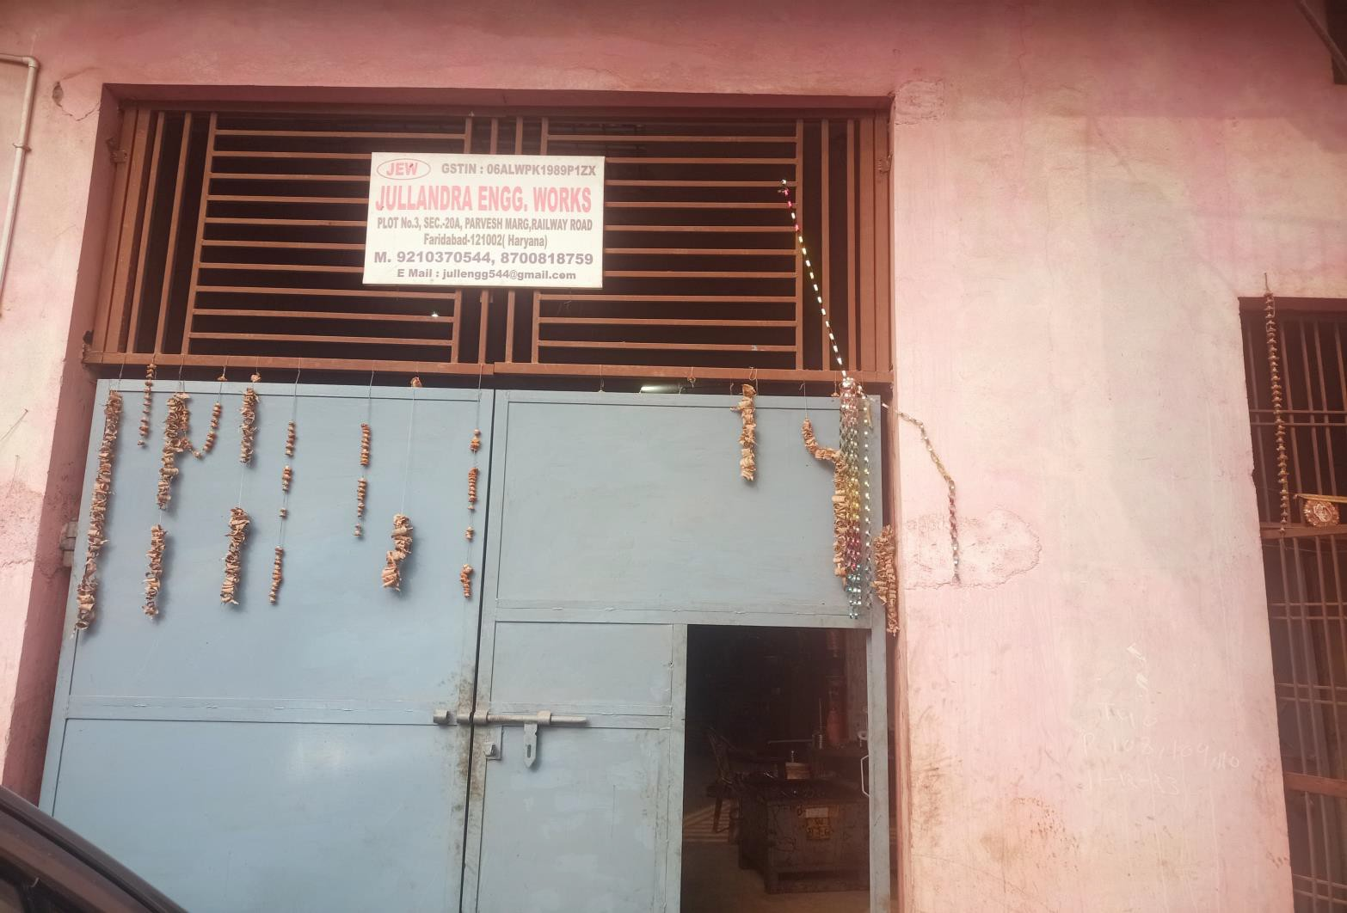
Manufacturing Unit

Slide 3
QUALITY POLICY
हम, उचित संिार, कमिाम ररय ं की सामचयक प्रचिक्षण, गणवत्ताु प्रबंधन प्रणाली,काननीू आवश्यकताओं के लगातार सुधार के
चलए, हमारे ग्राहक ं और इच्छु क पाचटमय ं की जरूरत ं ,उनकी संतुचि के अनसाु र ,प्रचतस्पधी मल्यू , समय पर चवतरण और
लागत प्रभावी गणवत्ताु वाले उत्पाद प्रदान करने का प्रयास करें ग।े
We, shall strive for by providing cost effective Quality product at competitive price and timely delivery as per needs of our customers and interested parties by Proper Communication , periodical training of employees, strict adherence to QMS and legal requirements & its continual improvement to enhance their satisfaction.

Slide 4
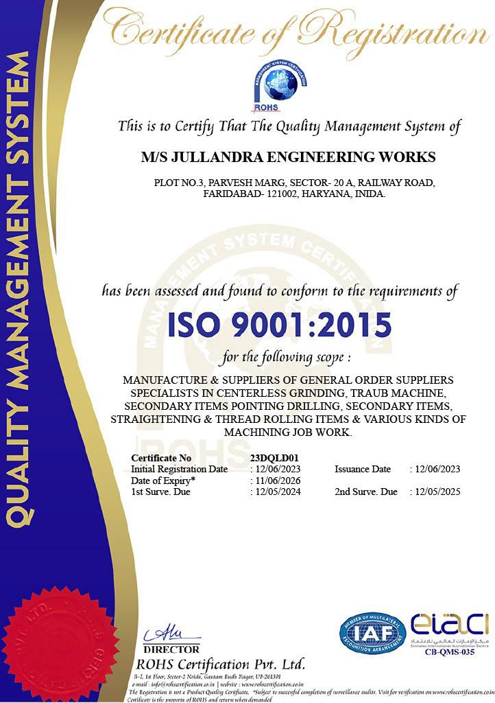
ISO CERTIFICATE

Slide 5
Vision & Our Mission
Vision:
"To be a globally recognized corporation that provides best automotive & electrical solutions, delivered by best-in-class people."
Mission:
To achieve our vision through fairness, business ethics, global reach, technological expertise, building long term relationships with all our associates, customers, partners, and employees.

Slide 6
Establishment…..
Year of Inception
Promoter
Structure
Certification
- 1988
Mr. MUKESH KUMAR
SSI
- ISO 9001:2015

Slide 7
Infrastructure…..
Total Available Land
Capacity Genset
-1500 Sq. Feet
- 1 Nos. 32 Kva
Material Handling Equipment Like Overhead Electric Crane 2 Ton -1 No

Slide 8
Organization…..
M.KUMAR
(properietor)
MR CHIRAG
(SYSTEM)
MR RAJENDRA (SUPERVISOR)
MR DEEPAK
(QA)
OPERATOR
HELPER

Slide 9
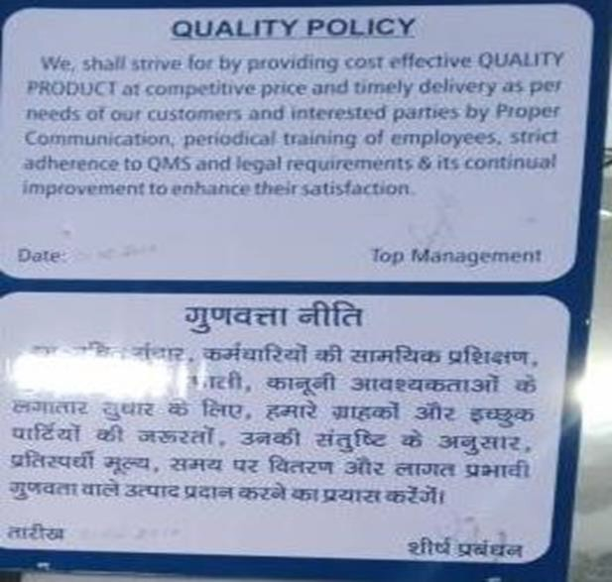
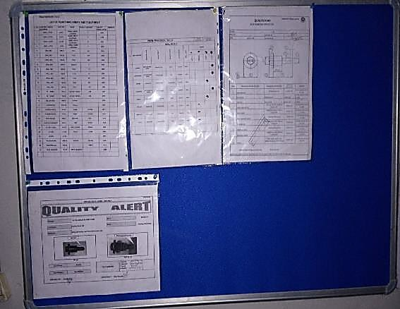
AWARENESS…..

Slide 10
Human Resource…
STAFF | - | 5
FORMAN | - | 2
OPERATOR | - | 4
HELPER | - | 2
Total - 13

Slide 11
Customer Base
STERLING TOOLS LTD
UBHI ENGG WORKS
NAINY EXPORT
USHA INDIA LIMITED
HINDUSTAN VACCUM GLASS

Slide 12
Business Growth (Rs. Lac)
27
26
25
24
23
22
21
20
26
25
Sales Rs. Lac
22
22
2019-20
2020-21
2021-22
2022-23 exp

Slide 13
Strength…..
In-depth Practical Knowledge of Sheet metal, Fabrication , Secondary operation of fasteners & Quality
In-house secondary operations of Sheet metal, Fabrication, screw & fasteners related m/c.

Slide 14
LIST OF INST…..
DESCRIPTION | QTY
VERNIER CALIPER 8” | 03
VERNIER CALIPER 6” | 02
MICROMETER 0-25 | 03
MICROMETER 25-50 | 02
PROFILE PROJECTOR | 01
BLADE M/M 0-25 | 01
PUPPY DIAL 0-0.8MM | 04
DIAL INDICATOR 8 MM | 05
SRFACE PLATE 18”X18” | 01
HEIGHT GAUGE 0-300 | 01
ANGLE PROTECTOR | 02

Slide 15
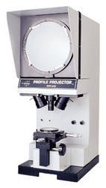
PROFILE PROJECTOR…..

Slide 16
LIST OF M/C…..
DESCRIPTION | QTY
ADDA LATHE | 5
DRILL M/C | 13
TAPPING M/C | 1
HAND PRESS | 1
POWER PRESS 30 T | 1
POWER PRESS 10 T | 1
TROAUB M/C | 4
SURFACE GRINDER | 1
ARC WELDING | 1
THREAD ROLLING M/C | 3
CENTERLESS GRINDING M/C 4" | 3
STRAIGHTENING MACHINE | 2

Slide 17
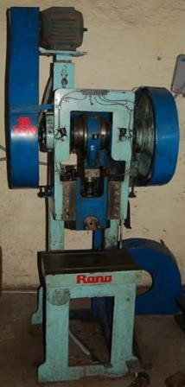
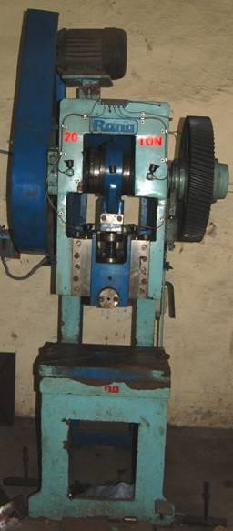
Scope of Manufacturing
THE COMPANY HAS A WIDE ARRAY OF PRODUCTION RESOURCES LIKE POWER PRESSES UPTO 20 TON CAPACITY

Slide 18
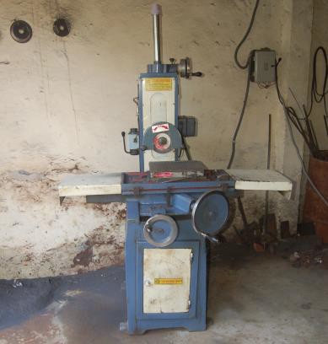
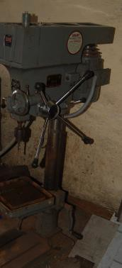
Infrastructure
SURFACE GRINDER 12”X8”
DRILL M/C 3 NO.

Slide 19
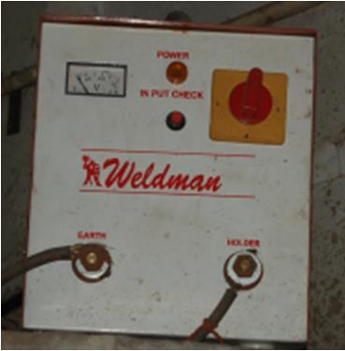
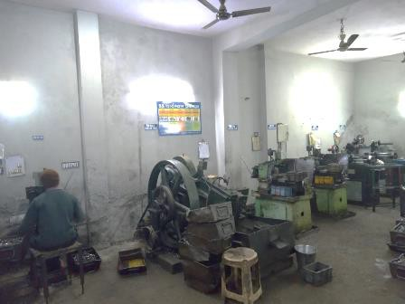
Infrastructure
ARC WELDING 400 AMP
TRAUB & ADDA LATHE

Slide 20
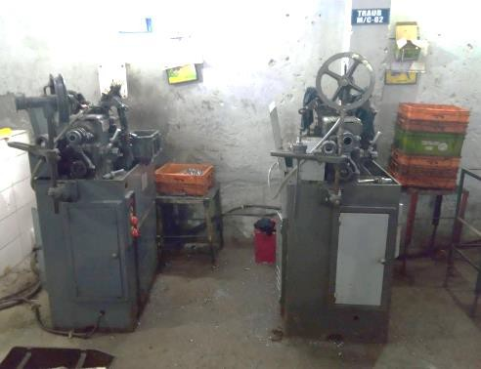
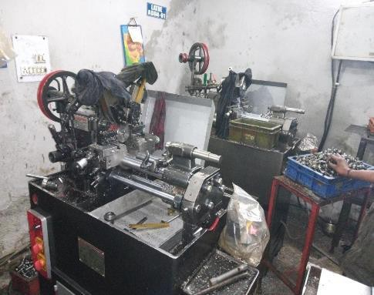
Infrastructure
Traub

Slide 21
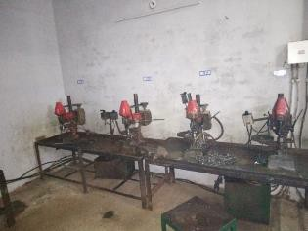
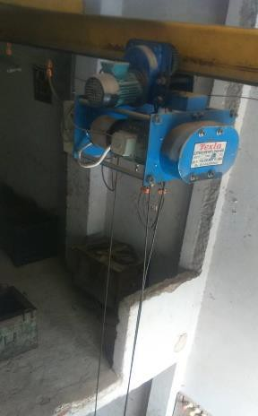
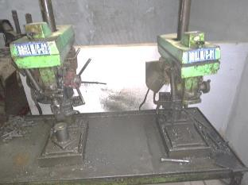
Infrastructure
DRILL MACHINE
ELECTRIC CRAIN 2 TON

Slide 22
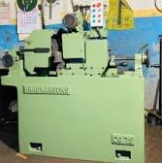
Infrastructure
CENTERLESS GRINDING MACHINE

Slide 23
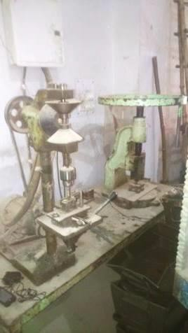
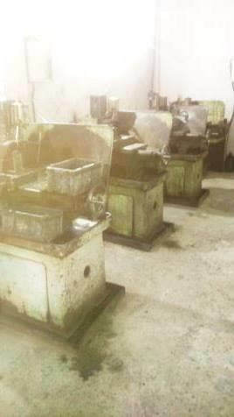
Infrastructure
TAPPING MACHINE
LATHE ADDA MACHINE

Slide 24
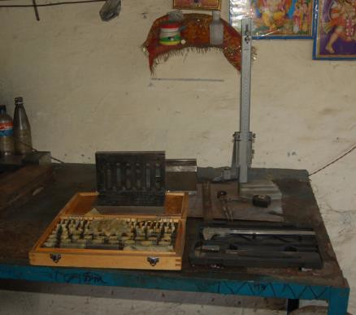
Instruments

Slide 25
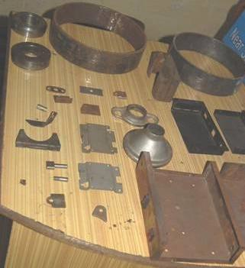
Components- Sheet metal Components

Slide 26
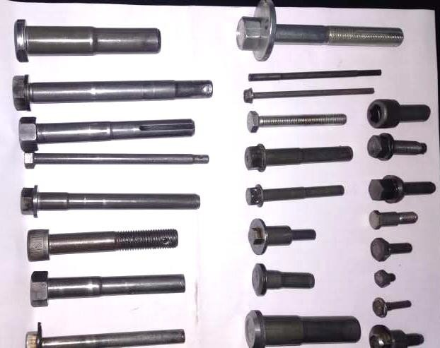
Components- Screw & Fasteners

Slide 27
Product Range…..
PRODUCT (DESCRIPTION)
NUT, BOLT SCREW & FASTENERS
SHEET METAL & FABRICATION COMPONENTS

Slide 28
Future Expansion Plan…
Addition of Traub
CNC M/c Machine– by2025-26
Addition of Centerless Grinder
Power Press

Slide 29
Essential Details…
Contact Details
: Mr. Mukesh +91-9210370544
Mr. Chirag +91-8700818759
Mail ID : jullengg544@gmail.com
chiragkumar101112@gmail.com
Address
: JULLUNDRA ENG WORKS
PLOT.NO-03,SECTOR-20A,
PERVESH MARG RAILWAY ROAD OLD FARIDABAD
State Haryana (India)-121002
: 06ALWPK1989P1ZX
GST ARN No.

Slide 30
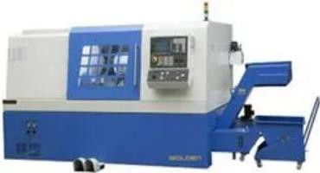
Scope of Manufacturing
THE COMPANY HAS A WIDE ARRAY OF PRODUCTION RESOURCES LIKE CNC TURNING CENTER

Slide 31
Thank You

